Slide 1

DETERMINATION AND ANALYSIS OF ARTHRITIS USING DIGITAL IMAGE PROCESSING TECHNIQUES

Slide 2
Index
Abstract
Introduction
Literature review
Existing Method
Drawbacks
Proposed method
Advantages
Applications
Hardware and Software Requirements
Results
Conclusion
References

Slide 3
ABSTRACT
Arthritis is a common disorder that affects your joints. It can cause pain and inflammation, making it difficult to move or stay active. This may sometimes leads to disability and chronic ill-health. In this study, MRI scans of the knee were analyzed. Estimating the volume or thickness of cartilage at the knee is crucial for determining arthritis. Before segmentation, the image is preprocessed with B-Splines creation. After that, canny and log edge detectors are used to fine-tune the edges. Finally, in order to determine cartilage thickness, the distance between the edges is computed. The number of pixels between edges is used to calculate the thickness. The abnormality of arthritis is then determined based on the thickness value. This is a quick and easy approach to evaluate if you have arthritis depending on the thickness of your cartilage.
Keywords: Arthritis, B-Spline, Anisotropic diffusion, Articular-cartilage.

Slide 4
INTRODUCTION
Arthritis is a disease that affects your joints (areas where your bones meet and move). Arthritis usually involves inflammation or degeneration (breakdown) of your joints. These changes can cause pain when you use the joint.
Arthritis is most common in the following areas of the body:
Feet.
Hands.
Hips.
Knees.
Lower back.

Slide 5
Literature Review:
S. No | Journal Type with year | Authors | Title | Outcomes
1 | MAGNETOM Flash, Feb/2013. | Jurgen Fripp, Erin Lucas, Craig Engstrom | Automated Morphological Knee Cartilage Analysis of 3D MRI at 3T | About image analysis and Image Processing in MRI’s (Magnetic Resonance Imaging).
2 | 6th International Conference on Emerging Technologies (ICET), 2010. | Syed Afaq Ali Shah, K. M. Yahya, G. Mubashar, Abdul Bais | Quantification and Visualization of MRI Cartilage of the Knee: A Simplified Approach | Bezier splines and anisotropic diffusion algorithm. Edge detection technique and canny edge detection.
3 | IJCSI International Journal of Computer Science Issues, Vol. 9, Issue 6, No 2, November 2012. | Arpita Mittal1, Sanjay Kumar Dubey | Analysis of Rheumatoid Arthritis through Image Processing | Image Enhancement and Restoration, Intensity adjustment with gamma correction, Histogram equalization, Median filters.

Slide 6
Literature Review:
S. No | Journal Type with year | Authors | Title | Outcomes
4 | IJCSI International Journal of Computer Science Issues, Vol. 10, Issue 2, No 3, March 2013 | Arpita Mittal , Sanjay Kumar Dubey | A Literature Review on Analysis of MRI Images of Rheumatoid Arthritis through Morphological Image Processing Techniques | Image Morpholgy, Dilation and Erosion operations.
5 | IJCSI, November 16, 2007. | Kelvin Ka-fai Leung | Longitudinal analysis of MRI images in rheumatoid arthritis | Bezier splines, Cartilage contour. Anisotropic diffusion, Edge detection techniques.
6 | IEEE Trans. Image Proc., Vol. 5, pp. 1539 – 1553, 1996. | Y.-L. You,W. Xu, A. Tannenbaum, andM. Kaveh | Behavioral Analysis of Anisotropic Diffusion in Image Processing | Noisy images and removing techniques.

Slide 7
Existing Method:
Edge Detection technique:
Edge detection is a technique of image processing used to identify points in a digital image with discontinuities, simply to say, sharp changes in the image brightness. These points where the image brightness varies sharply are called the edges (or boundaries) of the image.
There are various methods in edge detection, and the following are some of the most commonly used methods-
Prewitt edge detection
Sobel edge detection
Laplacian edge detection
Canny edge detection

Slide 8
Disadvantages in Existing Method:
Size of output will be shrunk.
Inaccurate and sensitive to noise.
Difficult to implement to reach real time response. Time consuming.

Slide 9
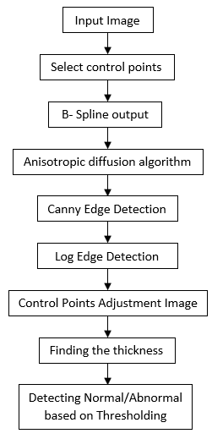

Proposed Method:
Block Diagram of Proposed Method

Slide 10
Proposed Method:
The visualization of quantitative result helps in determining and analysis of the arthritis disease.
The method is simple and efficient in attaining the aim of early arthritis detection based on cartilage thickness.
This algorithm can be improved further by implementing automated technique for threshold selection.
This technique can also be used for the determination of gap between the tibia and femur of knee for more accurate detection of arthritis.

Slide 11
Advantages of Proposed Method:
Size of the output will not be shrunk.
No loss of lot of valuable information, especially from the edges of the input image.
Insensitive to noise.
Easy to implement to reach real time response. Takes little amount of time.
It gives a good localization, response and is immune to a noisy environment.
Easy to detect edges and their orientations.
Gives the Accurate results.

Slide 12
Applications of Proposed Method:
In Medical Field.
This is ideal for removing noise but also indiscriminately blurs edges too.
Early detection of disease will be the scope for better treatment.

Slide 13
Hardware & Software Requirements:
Software: Matlab R2018a or above
Hardware:
Operating Systems:
• Windows 10
• Windows 7 Service Pack 1
• Windows Server 2019
• Windows Server 2016
Processors:
Minimum: Any Intel or AMD x86-64 processor
Recommended: Any Intel or AMD x86-64 processor with four logical cores and AVX2 instruction set support
Disk:
Minimum: 2.9 GB of HDD space for MATLAB only, 5-8 GB for a typical installation
Recommended: An SSD is recommended A full installation of all MathWorks products may take up to 29 GB of disk space
RAM:
Minimum: 4 GB
Recommended: 8 GB

Slide 14
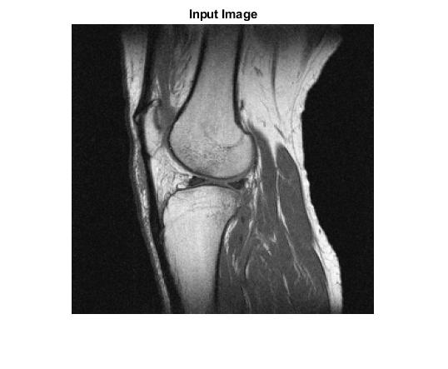
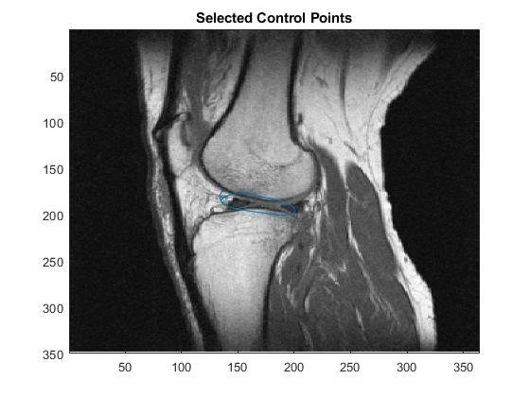
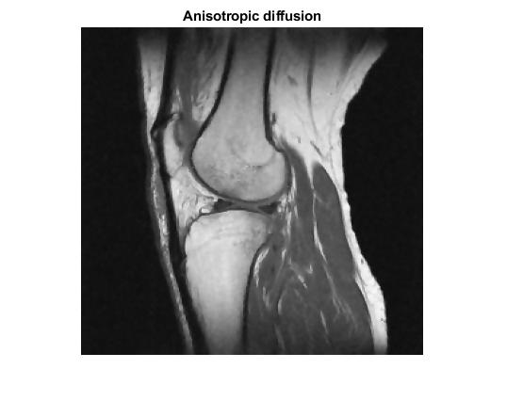
Results and Discussions:
Input Image Selected Control Points Anisotropic Diffusion

Slide 15
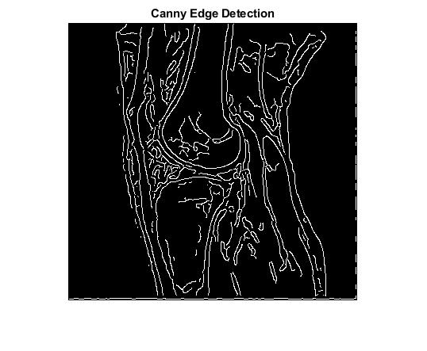
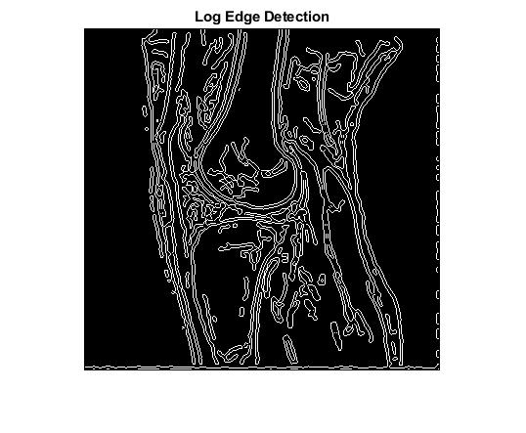
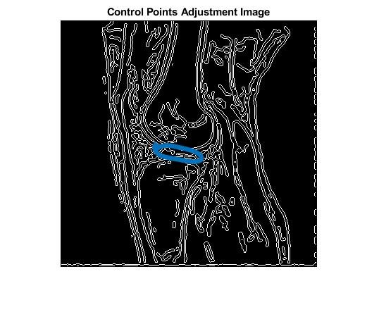
Results and Discussions:
Input Image Selected Control Points Anisotropic Diffusion

Slide 16

Results and Discussions:
Thickness & Condition

Slide 17
Conclusion:
The visualization of quantitative result helps in determining and analysis of the arthritis disease. The method is simple and efficient in attaining the aim of early arthritis detection based on cartilage thickness. This algorithm can be improved further by implementing automated technique for threshold selection. This technique can also be used for the determination of gap between the tibia and femur of knee for more accurate detection of arthritis.

Slide 18
Future Scope:
In this work we are determining whether a person have arthritis or not using image processing technique. We are using manual thresholding in this work, there is a future scope for automated thresholding for better results and reduction in time consumption. We can include Artificial Intelligence algorithms in future for better results in determination of the disease.

Slide 19
References:
[1] Jurgen Fripp, Erin Lucas, Craig Engstrom, “Automated Morphological Knee Cartilage Analysis of 3D MRI at 3T”, MAGNETOM Flash, Feb/2013.
[2] Syed Afaq Ali Shah, K. M. Yahya, G. Mubashar, Abdul Bais, “Quantification and Visualization of MRI Cartilage of the Knee: A Simplified Approach”, 6th International Conference on Emerging Technologies (ICET), 2010.
[3] Arpita Mittal1, Sanjay Kumar Dubey, “Analysis of Rheumatoid Arthritis through Image Processing”, IJCSI International Journal of Computer Science Issues, Vol. 9, Issue 6, No 2, November 2012.

Slide 20
References:
[4] Arpita Mittal , Sanjay Kumar Dubey, “A Literature Review on Analysis of MRI Images of Rheumatoid Arthritis through Morphological Image Processing Techniques”, IJCSI International Journal of Computer Science Issues, Vol. 10, Issue 2, No 3, March 2013.
[5] Kelvin Ka-fai Leung, Longitudinal analysis of MRI images in rheumatoid arthritis, IJCSI, November 16, 2007.
[6] Y.-L. You,W. Xu, A. Tannenbaum, andM. Kaveh, “Behavioral Analysis of Anisotropic Diffusion in Image Processing”, IEEE Trans. Image Proc., Vol. 5, pp. 1539 – 1553, 1996.

